Slide 1

SWEN20003 Workshop
  Week 10
Demonstrator: Xulin Yang

Slide 2
Workshop tasks
About project 1 – no submission people please discuss with me after workshop
Go through concept review
Divide groups by records
Do questions Q1, 2, 3, 4 together
Take attendance

Slide 3
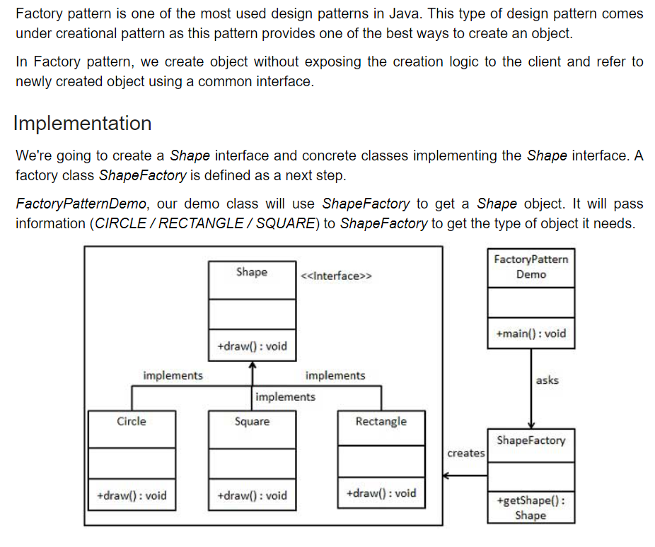
Design Pattern - Factory Pattern
Personal understanding: Group similar object’s creation logic together as a “factory”
https://www.tutorialspoint.com/design_pattern/factory_pattern.htm

Slide 4
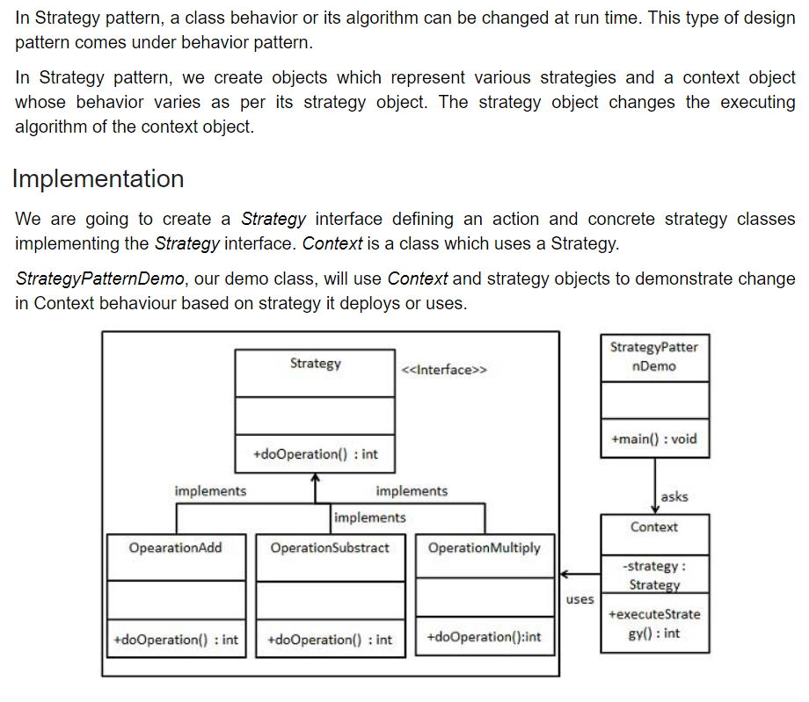
Design Pattern – Strategy Pattern
Personal understanding: You have different version of behaviors for your associated object
https://www.tutorialspoint.com/design_pattern/strategy_pattern.htm

